Slide 1
WELDING
DEPARTMENT OF MECHANICAL ENGINEERING
SUB CODE -18MES103L
SUB.NAME-BASIC CIVIL & MECHANICAL ENGINEERING WORKS
MAKE A LAP JOINT OF TWO METAL PLATES OVERLAPPING ON ONE ANOTHER PLATE USING ARC WELDING PROCESS

Slide 2
WELDING
Welding is a materials joining process which produces coalescence of materials by heating them to suitable temperatures with or without the application of pressure or by the application of pressure alone, and with or without the use of filler material.
Welding is used for making permanent joints.
It is used in the manufacture of automobile bodies, aircraft frames, railway wagons, machine frames, structural works, tanks, furniture, boilers, general repair work and ship building.

Slide 3
TYPES
Plastic Welding or Pressure Welding
The piece of metal to be joined are heated to a plastic state and forced together by external pressure
(Ex) Resistance welding
Fusion Welding or Non-Pressure Welding
The material at the joint is heated to a molten state and allowed to solidify
(Ex) Gas welding, Arc welding

Slide 4
Classification of welding processes:
(i). Arc welding
•
•
•
•
•
•
•
Carbon arc Metal arc Metal inert gas
Tungsten inert gas Plasma arc Submerged arc Electro-slag
(iv)Thermit Welding (v)Solid State Welding
Friction Ultrasonic Diffusion Explosive
Newer Welding
Electron-beam Laser
Related Process
Oxy-acetylene cutting Arc cutting
Hard facing Brazing Soldering
(ii). Gas Welding
•
•
•
Oxy-acetylene Air-acetylene Oxy-hydrogen
(iii). Resistance Welding
•
•
•
•
•
Butt Spot Seam
Projection Percussion

Slide 5
Arc welding
Equipments:
•
•
•
•
•
•
•
•
•
A welding generator (D.C.) or Transformer (A.C.) Two cables- one for work and one for electrode Electrode holder
Electrode Protective shield Gloves
Wire brush Chipping hammer Goggles

Slide 6
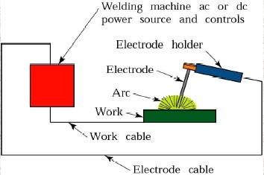
Arc Welding Equipments

Slide 7
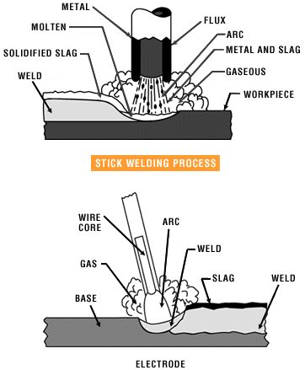
Metal arc welding

Slide 8
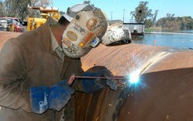
Arc Welding
Uses an electric arc to coalesce metals
Arc welding is the most common method of welding metals
Electricity travels from electrode to base metal to ground

Slide 9
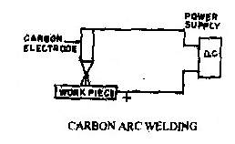
Carbon Arc Welding

Slide 10
Arc welding
Advantages
Most efficient way to join metals
Lowest-cost joining method
Affords lighter weight through better utilization of materials
Joins all commercial metals
Provides design flexibility
Limitations
Manually applied, therefore high labor cost.
Need high energy causing danger
Not convenient for disassembly.
Defects are hard to detect at joints.
•
•
•

Slide 11
Comparison of A.C. and D.C. arc welding
Alternating Current (from Transformer)
More efficiency
Power consumption less Cost of equipment is less
Higher voltage – hence not safe
Not suitable for welding non ferrous metals Not preferred for welding thin sections
Any terminal can be connected to the work or electrode

Slide 12
Comparison of A.C. and D.C. arc welding Direct Current (from Generator)
Less efficiency
Power consumption more Cost of equipment is more Low voltage – safer operation
suitable for both ferrous non ferrous metals preferred for welding thin sections
Positive terminal connected to the work Negative terminal connected to the electrode

Slide 13
GAS WELDING
•
Sound weld is obtained by selecting proper size of flame, filler material and method of moving torch
•
The temperature generated during the process is 3300⁰c
•
When the metal is fused, oxygen from the atmosphere and the torch combines with molten metal and forms oxides, results defective weld
•
Fluxes are added to the welded metal to remove oxides
•
Common fluxes used are made of sodium, potassium. Lithium and borax.
•
Flux can be applied as paste, powder,liquid.solid coating or gas.

Slide 14
GAS WELDING EQUIPMENT...
Gas Cylinders
Pressure
Oxygen – 125 kg/cm2 Acetylene – 16 kg/cm2
Regulators
Working pressure of oxygen 1 kg/cm2 Working pressure of acetylene 0.15 kg/cm2
Working pressure varies depends upon the thickness of the work pieces welded.
Pressure Gauges
Hoses
Welding torch
Check valve
Non return valve

Slide 15
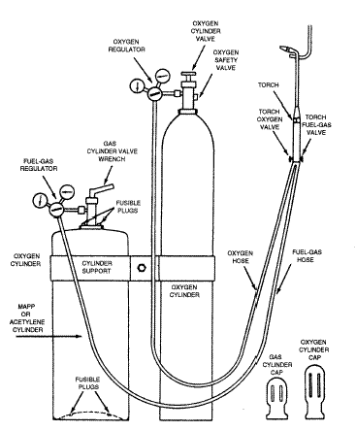
Oxy-Acetylene welding

Slide 16
TYPES OF FLAMES…
Oxygen is turned on, flame immediately changes into a long white inner area (Feather) surrounded by a transparent blue envelope is called Carburizing flame (3000⁰c)
•
•
Addition of little more oxygen give a bright whitish cone surrounded by the transparent blue envelope is called Neutral flame (It has a balance of fuel gas and oxygen) (3200⁰c)
Used for welding steels, aluminium, copper and cast iron
•
•
If more oxygen is added, the cone becomes darker and more pointed, while the envelope becomes shorter and more fierce is called Oxidizing flame
Has the highest temperature about 3400⁰c Used for welding brass and brazing operation
•
•

Slide 17
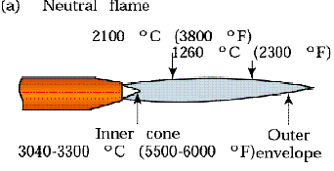
Three basic types of oxyacetylene flames used in oxyfuel-gas welding and cutting operations: (a) neutral flame; (b) oxidizing flame; (c) carburizing, or reducing flame.

Slide 18
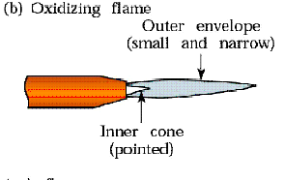
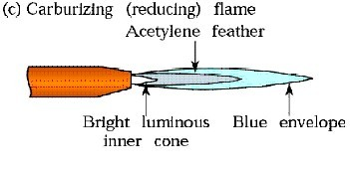
Three basic types of oxyacetylene flames used in oxyfuel-gas welding and cutting operations:
(a) neutral flame; (b) oxidizing flame; (c) carburizing, or reducing flame.

Slide 19
GAS CUTTING
•
Ferrous metal is heated in to red hot condition and a jet of pure oxygen is projected onto the surface, which rapidly oxidizes
Oxides having lower melting point than the metal, melt and are blown away by the force of the jet, to make a cut
Fast and efficient method of cutting steel to a high degree of accuracy
Torch is different from welding
Cutting torch has preheat orifice and one central orifice for oxygen jet
PIERCING and GOUGING are two important operations
Piercing, used to cut a hole at the centre of the plate or away from the edge of the plate
Gouging, to cut a groove into the steel surface
•
•
•
•
•
•
•

Slide 20
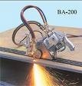
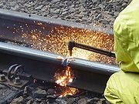
GAS CUTTING…
Automatic Gas Cutting
Manual Gas Cutting

Slide 21
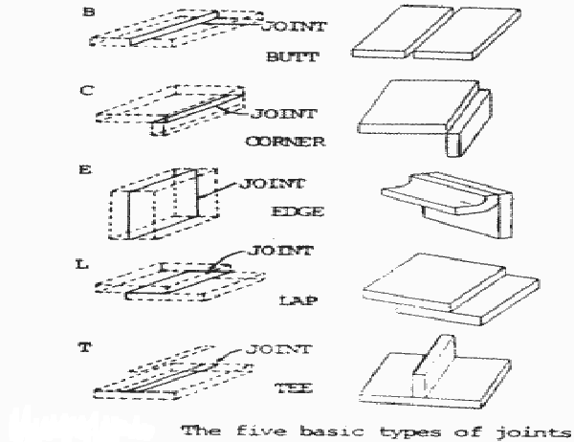
Weld joints

Slide 22
Brazing and Soldering
•
Brazing
It is a low temperature joining process. It is performed at temperatures above 840º F and it generally affords strengths comparable to those of the metal which it joins. It is low temperature in that it is done below the melting point of the base metal. It is achieved by diffusion without fusion (melting) of the base
Brazing can be classified as
Torch brazing Dip brazing Furnace brazing Induction brazing

Slide 23
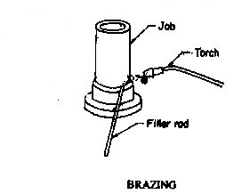
Brazing

Slide 24
Advantages
& Disadvantages
Advantages
•
•
•
•
Dissimilar metals which canot be welded can be joined by brazing Very thin metals can be joined
Metals with different thickness can be joined easily
In brazing thermal stresses are not produced in the work piece. Hence there is no distortion
Using this process, carbides tips are brazed on the steel tool holders
•
Disadvantages
•
•
•
Brazed joints have lesser strength compared to welding Joint preparation cost is more
Can be used for thin sheet metal sections

Slide 25
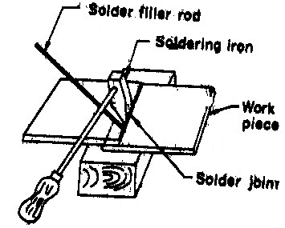
Soldering
•
It is a low temperature joining process. It is performed at temperatures below 840ºF for joining.
Soldering is used for,
Sealing, as in automotive radiators or tin cans
Electrical Connections
Joining thermally sensitive components
Joining dissimilar metals
•

Slide 26
Aim:
EXPERIMENT 11. LAP JOINT
To make a lap joint on the given work pieces using arc welding.
Apparatus required:
Work pieces, Welding electrodes, Welding machine, Tongs, Wire brush, chipping
hammer, Gloves and Goggles.

Slide 27
Procedure:
1. The given work pieces are cleaned with the wire brush to remove the rust, scale and other impurities.
2. Edges are prepared suitably to the given dimension and positioned one over another for the lap joint.
3. Depending upon the thickness of the parent metal, the amperage and correct voltage is selected.
4.With goggles covering the eyes and gloves on hands, an arc is struck on the work piece and tacks are made at the extreme ends.

Slide 28
5.Welding process is progressed along the seam at a constant speed and keeping uniform distance between the electrode and the work piece.
6. Using chipping hammer the flux in the form of slag is chipped off and then cleaned.
7. After welding, the work pieces should be handles only using the tongs.
Result:
Thus the required lap joint is obtained as per the given dimensions

Slide 29
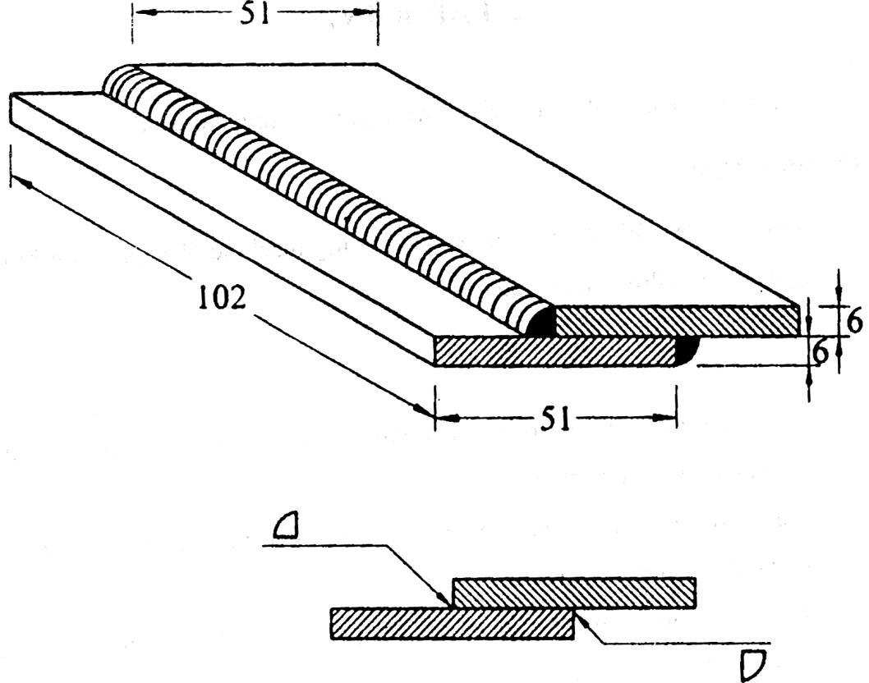
LAP JOINT

Slide 30
Result:
Thus the required butt joint is obtained as per the given dimensions.

